Slide 1
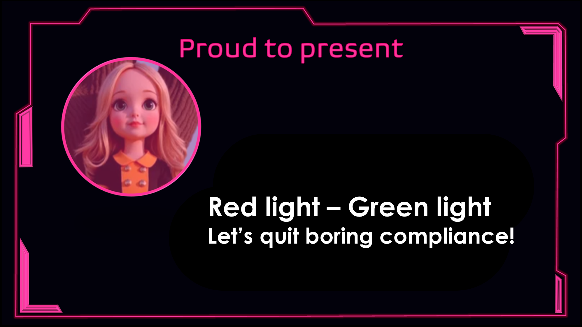
Red Light – Green Light
Let’s quit boring compliance!
GAME DESIGN DOC
NEXT

Slide 2
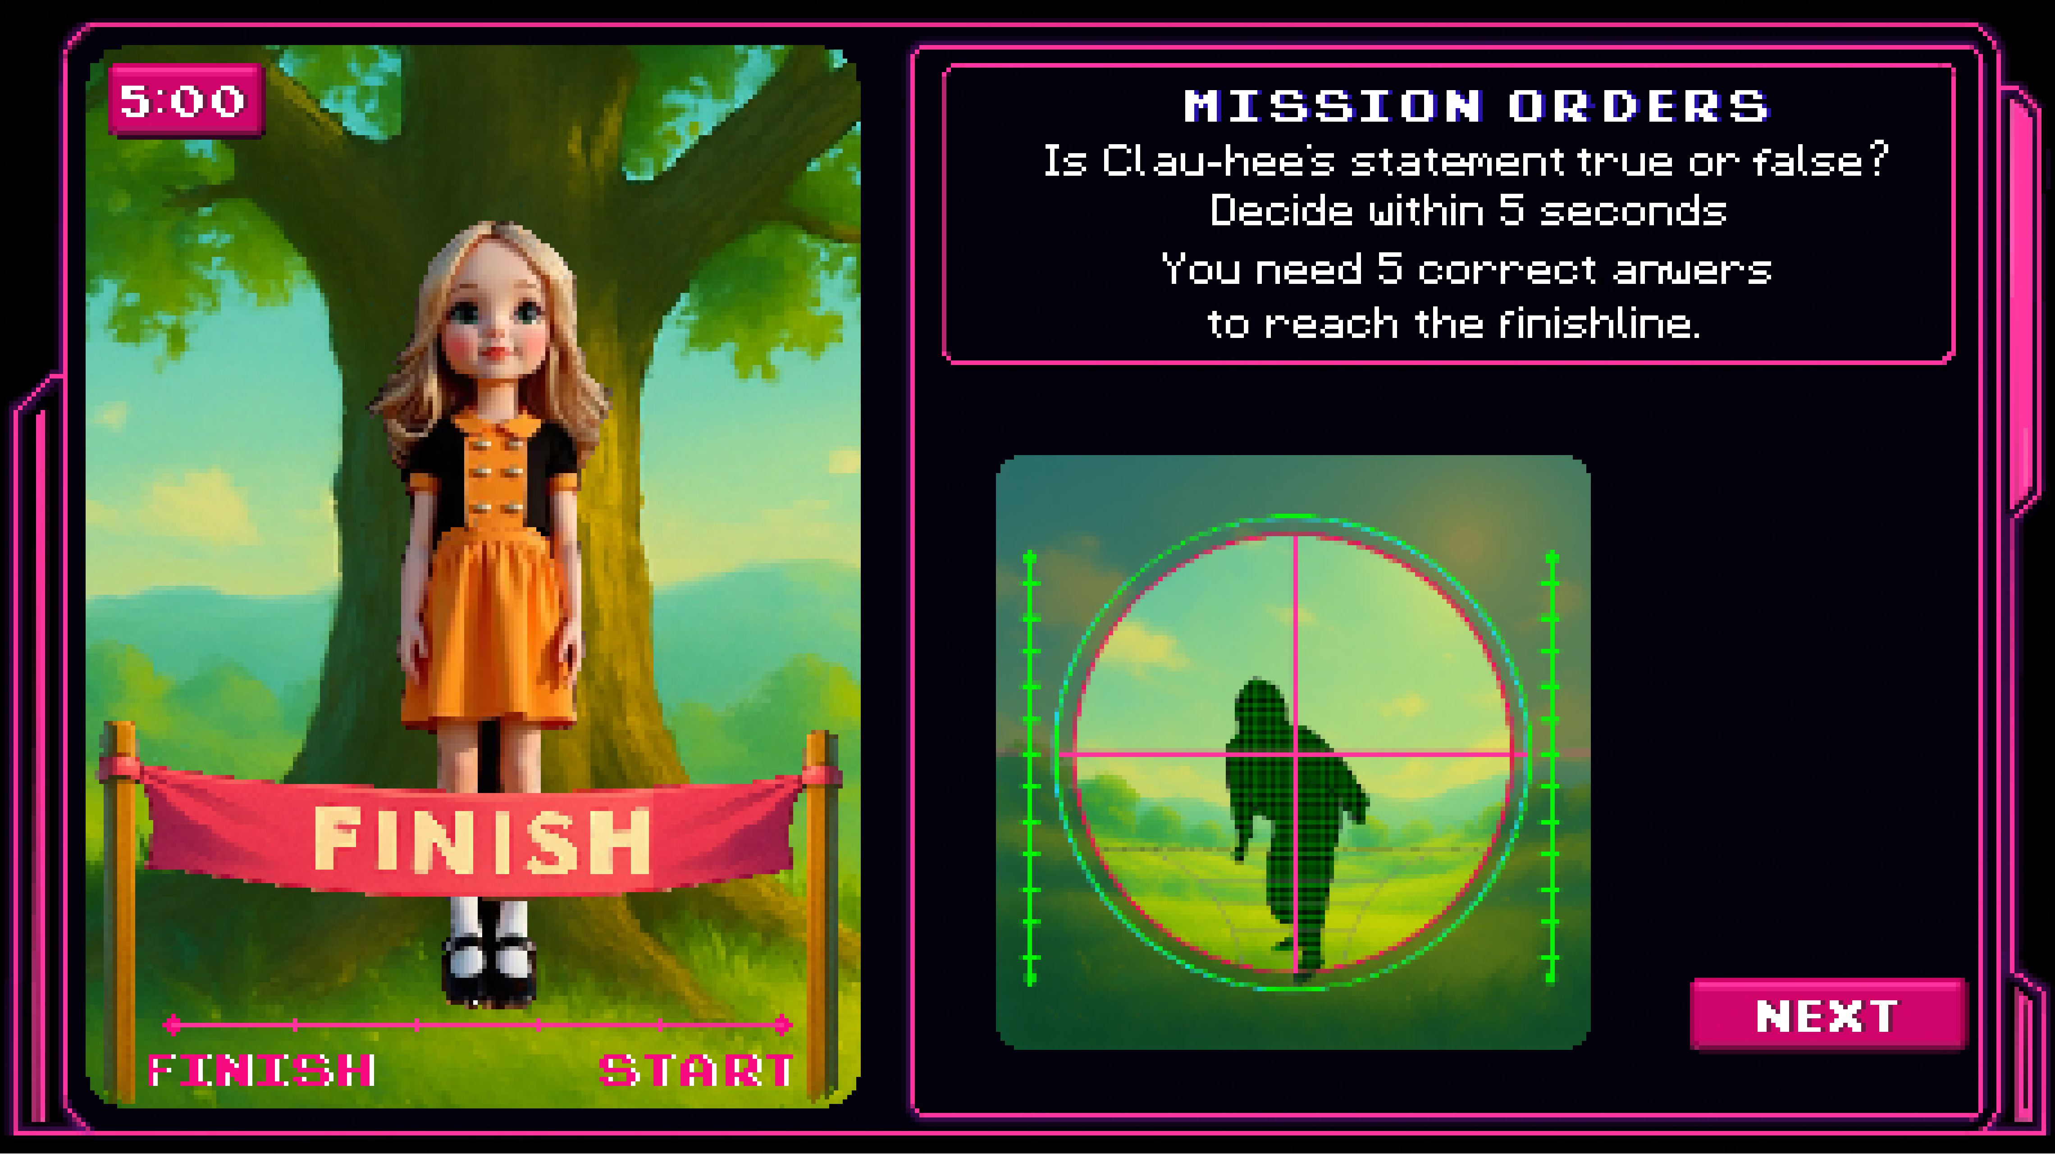
Let’s Quit Boring Compliance!
One wrong move, and you're out…
In this game, knowing the rules isn't just helpful — it’s your only way forward.
You’ll be assigned 3 missions. Study them carefully. You only get 5 chances.
Clau-Hee, scans for any signs of non-compliance.
Answer wrong? That’s movement. You’re caught. You’re out.
🟢 Green light — move forward.
🔴 Red light — wrong answer? Elimination.
Five questions. Five Seconds. One chance.
Think fast, stay sharp!
Ready to prove compliance isn’t boring — but a matter of survival?
Let the test begin…
Notes:
What do we do with the text on this slide? How do we get it in pixel text?

Slide 3
Start as a humble scroll student, rise to become the Red Flag Sniper. Pick your path and prove your scroll-fu. Choose wisely. Clau-Hee’s always watching… 👀
🐣 Beginner – "Compliance Curious"
You’ve survived HR onboarding and know that bribing your way to free coffee probably isn’t allowed. This level is for the newly initiated — gentle scrolls, clear statements, and a green light more often than not. Mistakes are learning moments, not lawsuits.
🧐 Intermediate – "Policy Padawan"
You’ve skimmed a policy PDF once and lived to tell the tale. At this level, you'll face murkier scenarios — timing, transparency, and terminology start to matter. Be alert, or you’ll be eliminated before you can say “intent to influence.”
🧠 Advanced – "Scroll Master"
You’ve quoted the Code of Conduct at parties. You know when a gift is too good to be true. Expect traps disguised as technicalities, phrasing that plays mind games, and zero tolerance for half-baked logic. One wrong move and it’s a red light for you.
🦾 Champion – "The Red Flag Sniper"
You’ve memorized the exceptions to the exceptions and can smell a compliance breach from 50 meters. This is elite mode — zero room for error, and everything is a potential red flag. Only the bold, the brilliant, or the slightly obsessed survive this level.
◻
◻
◻
◻
NEXT
START

Slide 4
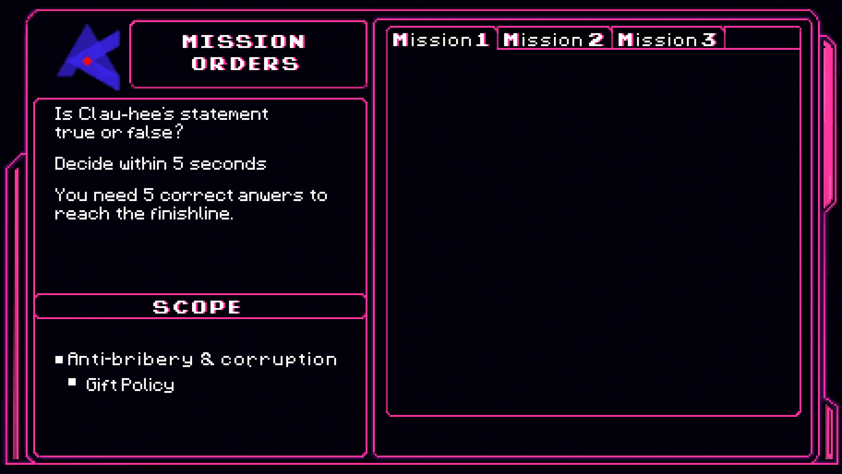
Gifts must never be cash or cash equivalents (e.g. gift cards, vouchers).
Gift value must be below the applicable threshold (global €50 or strictest local threshold).
Gifts must not be offered to or received from government officials or their family.
Gifts should serve a legitimate business purpose and be given transparently (openly, not in secret).
Hospitality events where the host is present are not considered a gift. The Hospitality Policy applies.
If all criteria met → register for approval; If you receive a gift that does not meet the criteria, politely decline or return.
To the right you will find 3 files with mission orders. Please read the mission rules carefully and memorize them. You will get 5 statements. Are they true or false?
You need 5 correct statements to reach the finish line.
START
Notes:
1. Also here we need to see what it looks like when we add the text of the scrolls; will it even fit on the page? If not; can the user scroll through the text? Ideally it should fit. I think we need to look carefully at the resolution/pixel sizes. The text: Is Clau-hee’s statement true or false is 7x7 pixel. But as you can see it is quite big. If we can have a font that looks a bit pixel-y we could choose to only have the big text in pixel but the smaller text not.
2. Instead of: Is Clau-hee’s statement true or false? Decide within 5 seconds. You need 5 correct answers to reach the finish line. Need to be replaced by an instruction that the user needs to memorize the rules of the missions. I didn’t change this yet because it’s s much work and we need to decide on the pixel first.

Slide 5
they click start
START

Slide 6
1. Start sound
0 Girl turns to tree - secs
1. Timer starts to run
1. Statement appears
2. Girl turns to audience
2. After 5 seconds. Stop sound
3. You see the radar scan.
4. You see the result (true is the correct answer) or wrong game over
4. Green dot appears at the first stage
5. User click next- start at 0
START

Slide 7
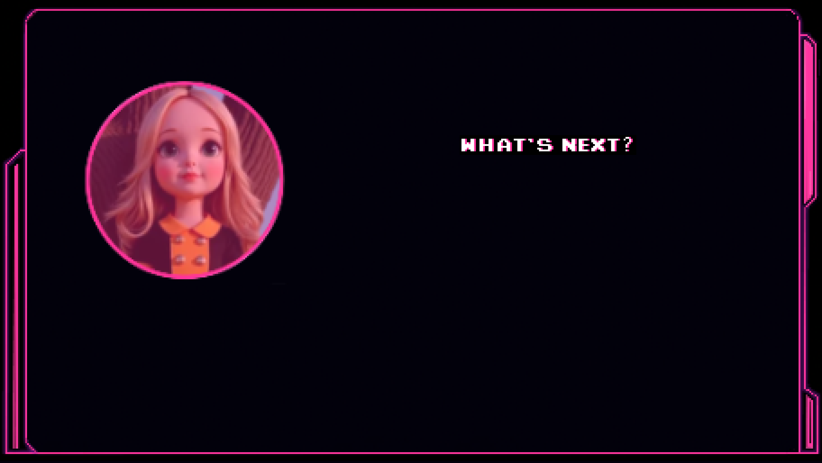


Change Difficulty and Try again.

Slide 8

Order
Opening slide: Proud to present
Slide 2: text explaining the rules
Slide 3: Player to choose the difficulty level
Slide 4-5-6 the 3 mission scrolls the user needs to memorize. 1 background picture per tab
Slide 7 opening of the game with mission statement; when they click start;
  Clau-Hee turns to the tree (4 frames),
  At the same time the statement appears
  At the same time the clock starts the countdown
  In the bottom we see the green dot move to the next stop
  When the five seconds are over; we see the

Slide 9

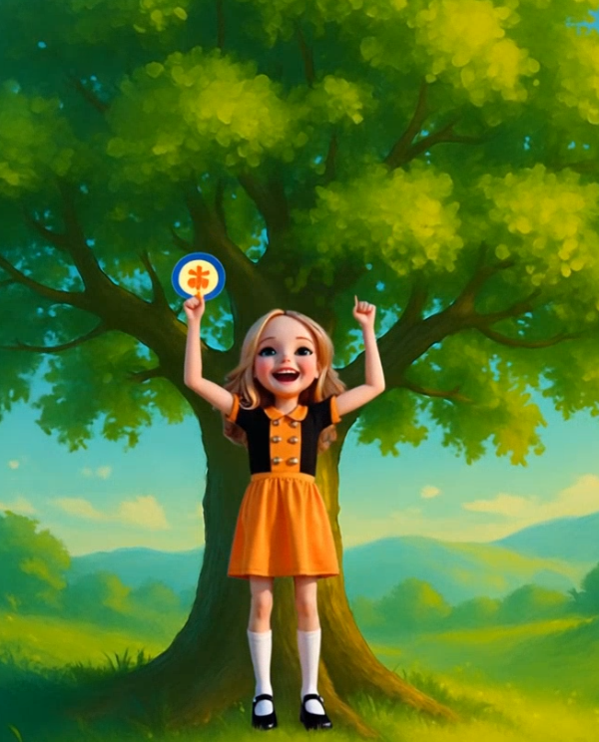
Order
  2 options:
    If the answer is correct; the user sees the message: No movement detected. And in the statement box: true/false is the correct answer (in later version I think we should add an explanation, but that is out of scope now).
    If the answer is incorrect or the user didn’t react in time; the user sees the message: Movement detected! And in the statement box: true/false is not the correct answer. Game over!
  The next button appear and they can move to the second statement
  Repetition of steps 1-7
  Every time the dot moves to the next marker
  After 5 correct answers the finish ribbon breaks;
  maybe we can show ClauHee jumping for joy (add the 5 second gif)
  Display congratulations.

Slide 10
Scrolls
There are 21 scrolls
  1-4 difficulty ¼
  5-10 difficulty 2/4
  11-16 difficulty ¾
  17-21 difficulty 4/4
    Every scroll has 5-6 rules
    9 true false statements
      3 difficult
      3 medium
      3 hard
The user gets assigned 3 scrolls randomly from their chosen difficulty level. They need to learn the rules on the scrolls by heart. Out of the 27 statements for the 3 selected scrolls, 5 statements are randomly selected for the game. Easy to start e.g. first 1or 2 statements, then getting harder e.g. statements 2, 3, 4 medium and, hard statement 4 and 5. As long as statement 1 is easy and 5 is hard it’s ok, i.e. the model can randomly select

Slide 11


